Slide 1
TEAM DETAILS AND PROBLEM STATEMENT
PROJECT: THE GATEWAY TO CONNECT ORGANIZERS AND VOLUNTEERS
Team Name:-Binary Brains
SUYASH LAGAD
SANKET NATEKAR
PRANAV SURYAVANSHI
RUSHIKESH ALWEKAR

Slide 2




TECH STACK USED :
HTML
NLP
CSS
JS

Slide 3
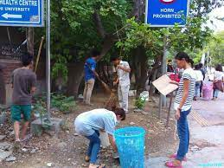
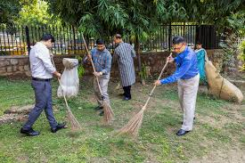
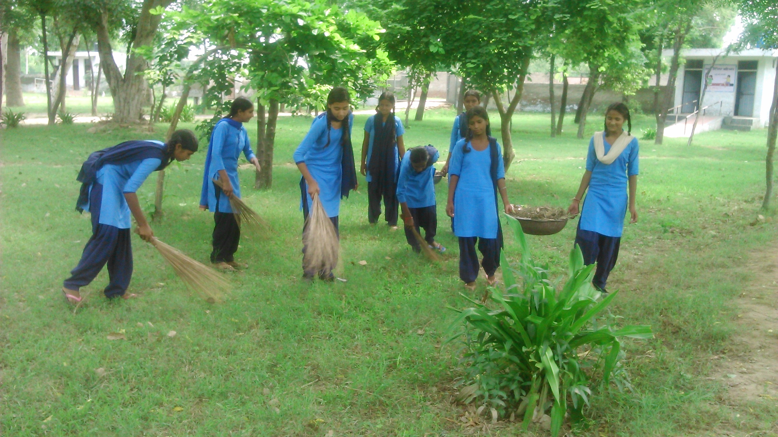
OUR MISSION :
At CLEANUP our mission is to foster a cleaner and healthier environment by engaging communities in proactive cleanliness initiatives. We believe that a clean environment not only enhances the quality of life but also promotes a sense of pride and responsibility among citizens.

Slide 4
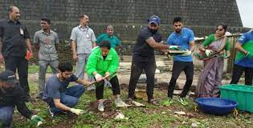
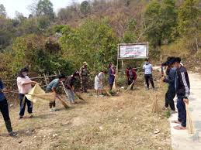
INTRODUCTION :
Welcome to the CLEANUP Presentation!
At Cleanliness Program, we are dedicated to fostering cleaner and healthier communities through active engagement and collaboration. Our website serves as a central hub for connecting organizers and volunteers for various cleanliness initiatives.
Through innovative technology and community-driven efforts, we aim to make a tangible impact on environmental sustainability and public health. Join us as we work together to create a cleaner and greener future for all.

Slide 5
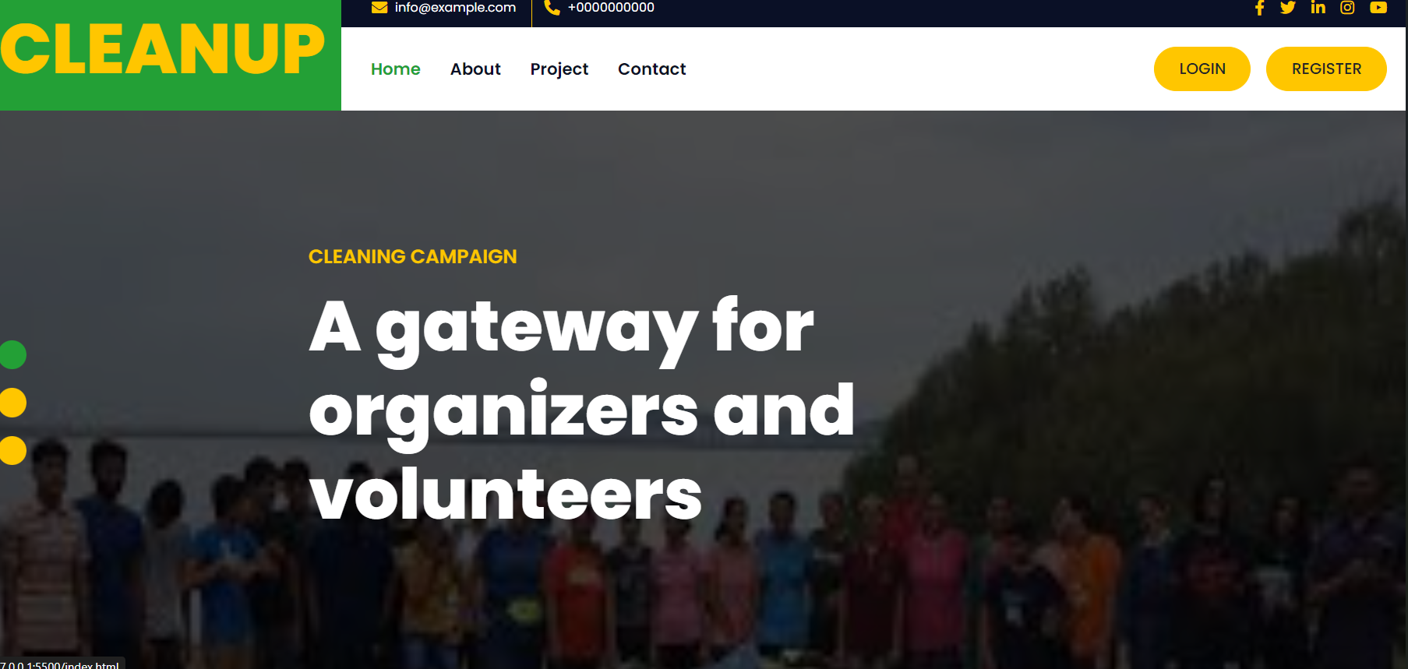
Our solution:
Connecting Organizers and Volunteers: Our website serves as a comprehensive platform for organizers to post cleanliness initiatives and for volunteers to discover and participate in these opportunities.
Efficient Coordination: Say goodbye to cumbersome manual processes! Our website streamlines the coordination process, allowing organizers to efficiently manage tasks and communicate with volunteers in real-time.
AI-Powered Volunteer Assistance: We've integrated a personal AI bot into our platform to provide tailored assistance and support to volunteers throughout their volunteering journey.

Slide 6
LET’S TALK ABOUT BENIFITS:
For Organizers : FOR THOSE WHO ARE GOING TO ORGANIZE CAMPAIGN
For Volunteers : FOR THOSE WHO ARE PARTICIPATING IN CAMPAIGN ON INDIVIDUAL LEVELS

Slide 7
For Organizers
Efficient Organization: Our platform streamlines the process of organizing cleanliness initiatives, saving time and effort for organizers.
Enhanced Communication: Organizers can easily communicate with volunteers, assign tasks, and provide updates in real-time, fostering better collaboration.
Data Insights: Access valuable data and insights on volunteer engagement and participation to optimize future initiatives and improve outcomes

Slide 8

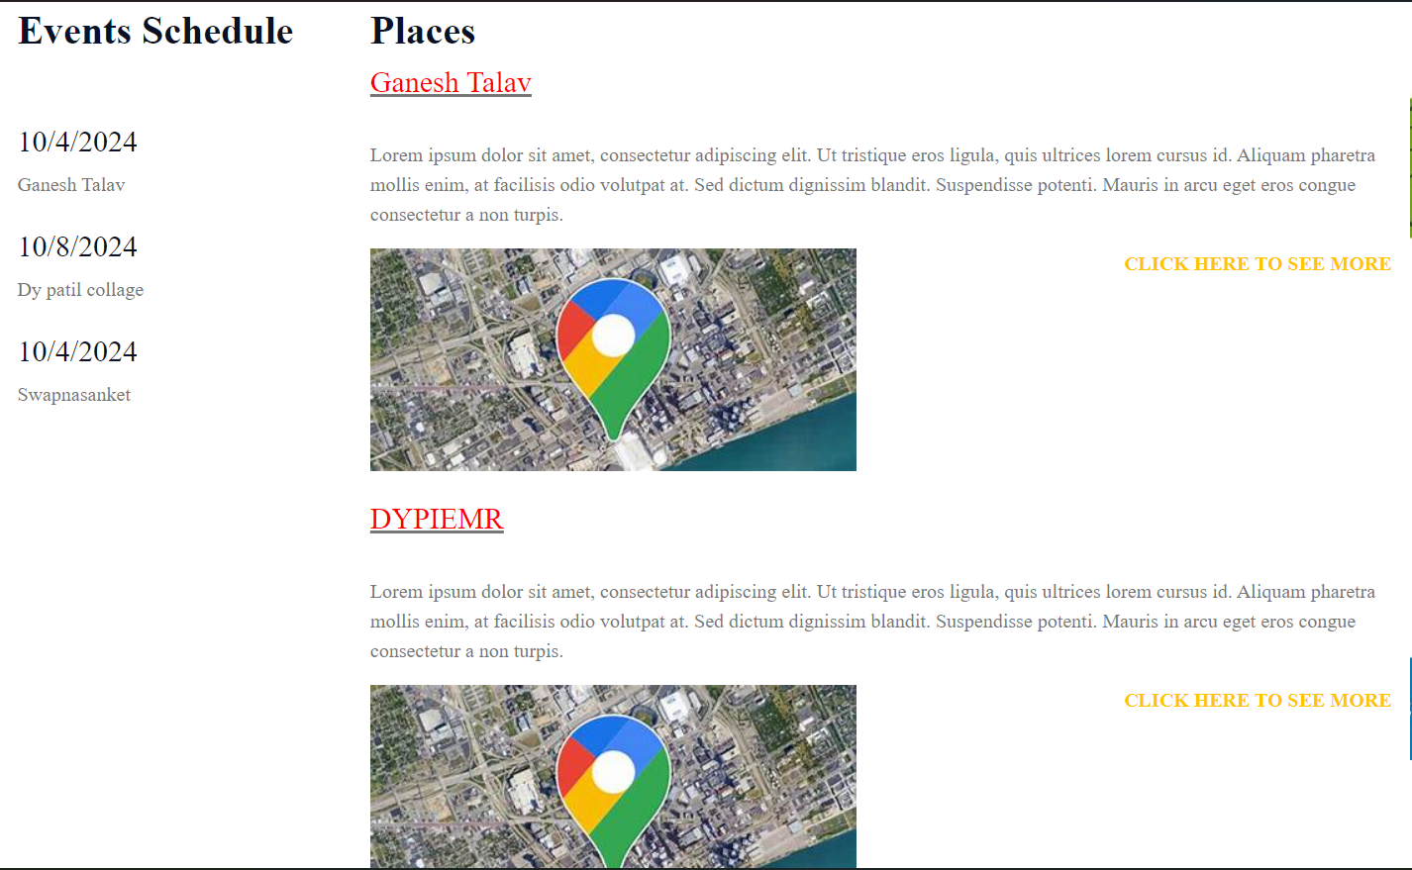
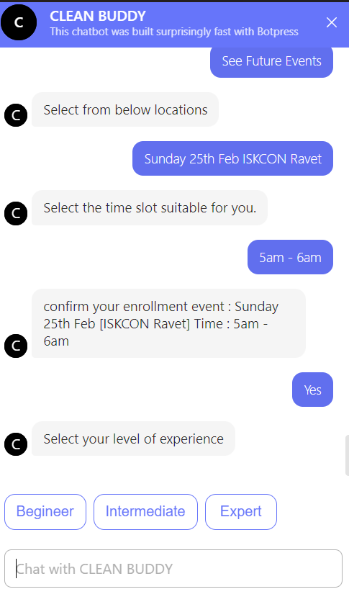
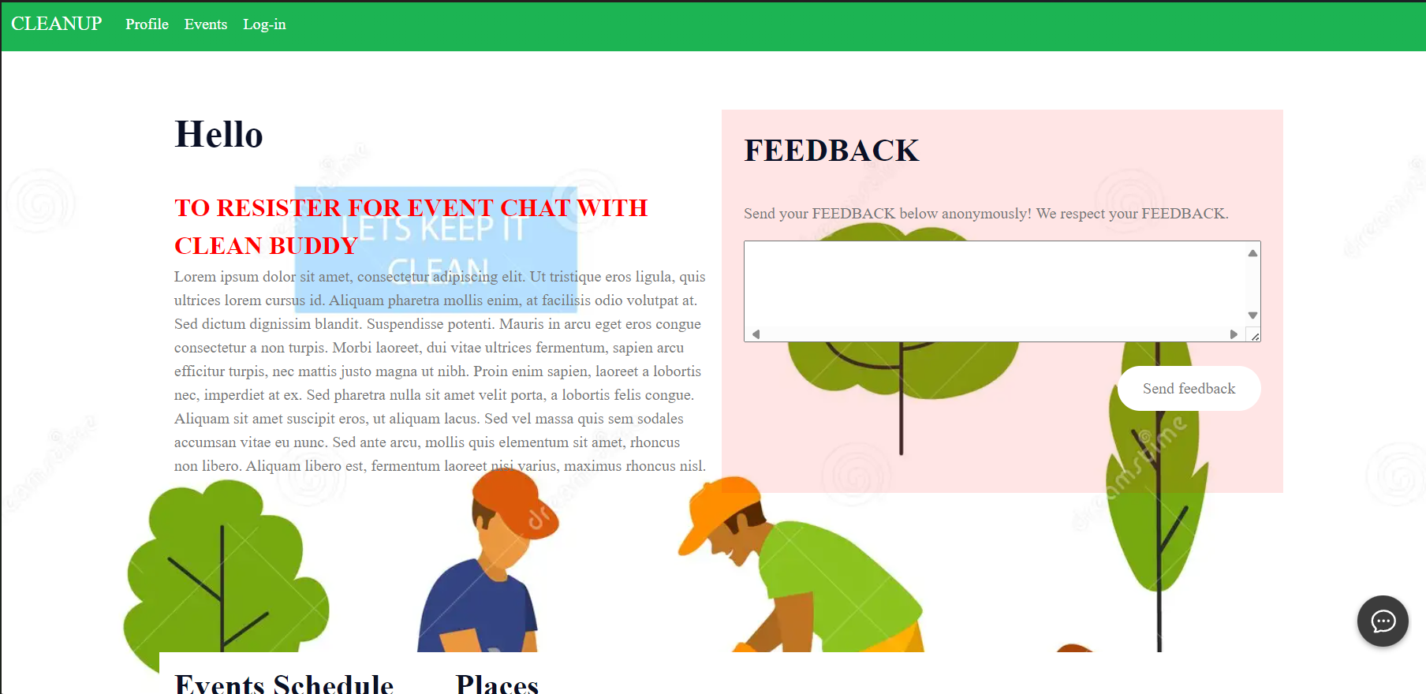
For Volunteers:
Easy Access to Opportunities: Find and participate in cleanliness initiatives effortlessly, with our user-friendly search and filtering options.
Personalized Support: Receive personalized assistance and guidance from our AI bot throughout your volunteering journey, ensuring a smooth and rewarding experience.
Community Engagement: Make a meaningful impact on your community and environment while connecting with like-minded cleaners.

